Slide 1
Forecasting Inflation
for Profit
FINM 35000 Final project
Nov 29, 2023
Juan Ramirez, Yang Bao, Jun Lee
Notes:
My name is Juan Ramirez and this is Yang and we’re team 10. The name of our presentation is forecasting inflation for profit, and as the name implies we decided to create a trading strategy revolving around inflation, so lets get right to it.

Slide 2
Outline
Introduction
Data
Methodology
Results for Inflation Forecast
Strategy result and performance Benchmarks
Future Steps and Conclusion
Notes:
Skip

Slide 3
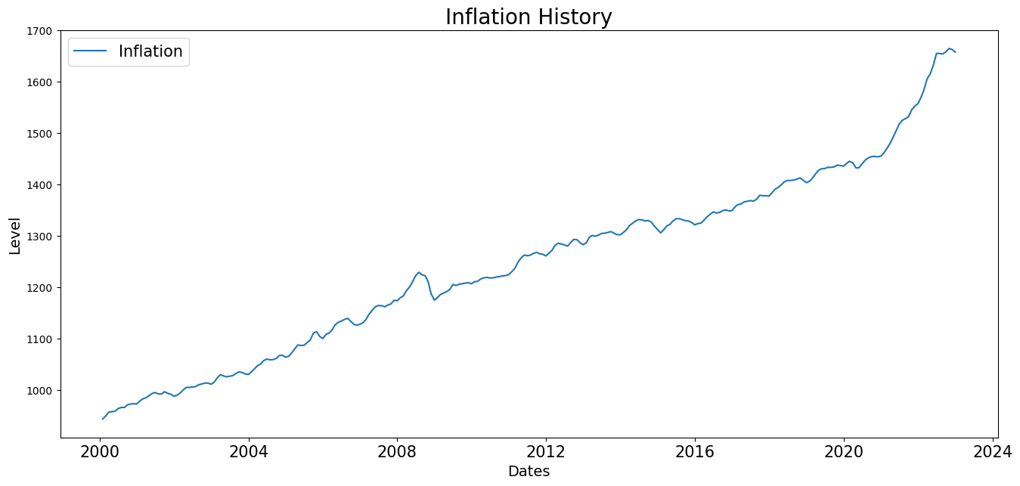
Introduction - Inflation
Notes:
So the reason why we decided to do inflation is because of the large movements that have happened over the past few years. As this large economic movements in one direction happen you think that it opens the door for interesting investment opportunities.
These things don’t happen out of nowhere - there must be a few leading indicators that allow us to know this might happen
So our idea is: if we can somehow forecast these large inflationary movements AND find securities that correlate highly with inflation, then in theory we can create and investment strategy around the inflation forecasts and those securities.

Slide 4
Introduction - Strategy
Forecast inflation to have an idea about the direction of inflation in the coming months
Auto-regressed macroeconomic indicators
natural language processed government documents on inflation topics implemented with multivariate regression model
Incorporate sentiments on expectation of inflation as signal
With these forecasts, purchase securities that are closely correlated with inflation based on our forecast with the goal of making profit.
Notes:
So that is essentially the gist of our strategy - to create a forecast and then use it as signals to trade securities.

Slide 5
Data
Selected Securities:
TIPS: an ETF that seeks to track the investment results of an index composed of inflation-protected U.S. Treasury bonds.
VNQ: an ETF of stocks issued by real estate investment trusts (REITs), companies that purchase office buildings, hotels, and other real property.
DBC: an ETF index composed of futures contracts on 14 of the most heavily traded and important physical commodities in the world
Timeframe for all securities begin at 2005 to 2023, resampled to monthly cadence.The selected this time range to include 2008-09 financial crisis and 2019-22 COVID-related downturn
ETF TIPs data and macroeconomic indicators, such as
Fed funds rate
Monetary Policy (i.e. Quantitative Easing/Tightening)
Unemployment
Wages
Government spending
Corporate Profits
FOMC meeting releases in text
Notes:
So these are the securities we used for our analysis.
Again, we wanted to some securities that would be dependent or influenced by inflation movements
Describe the securities we’re using
For simplicity we’re using ETFs here
Similarly for economic indicators, we wanted to choose economic measurements or leading indicators; I think all of these make sense

Slide 6
Methodology
Forecast variable: inflation level
Independent variables: macroeconomic data points
Multivariate OLS regression
3-month lagged forecasts on inflation level
Test group from 2021-08-01 to 2022-06-30
Autoregressive Analysis
Addressed stationarity and seasonality on independent variable selections
Selected Ganger Causation Variables
Constructed VARMAX model with p=3 and q=0
Test group from 2021-08-01 to 2022-06-30
Trading signals
Comparison of Inflation level forecast and actual value
Incorporation of NLP evaluation on FOMC meeting notes
Moving direction of monthly PPI and CPI releases
Notes:
Initially we tried an OLS regression to see how that would perform as a forecast, and then we tried a more sophisticated Autoregressive FORECASTING model
Instead, we used an autoregressive model known as Varma. A few people here might be familiar with it, but for those haven’t seen it it’s essentially a forecasting model that uses variational autoregressions specialzed to be used with multiple variables. In order to tune the model we ran what is called a granger causation analysis to understand which lagged variables might be the most informative of inflation
The idea is then to train each security on based on actual inflation movements and then once trained used our forecast as signals in order to trade these securities in our advantage. (i’ll explain more of this in future slides)

Slide 7
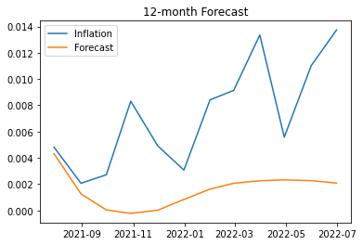
Results for Inflation Forecast
The Multivariate OLS regression model tested the most poorly out of all the models in terms of forecasting accuracy
Varma was our forecasting model
Auto-Regressive model specialized for multivariable analysis
Results using all six indicators were mixed
We cut down to only three leading indicators: Monetary Policy, Corporate Profits, and Wages.
These were chosen by performing a Granger Causation analysis
A 12-month forecast was not very accurate, but the short-term forecast captured the general direction of forecast. This is all we need!
We continued our strategy analysis using a rolling forecast of just one month.

Slide 8
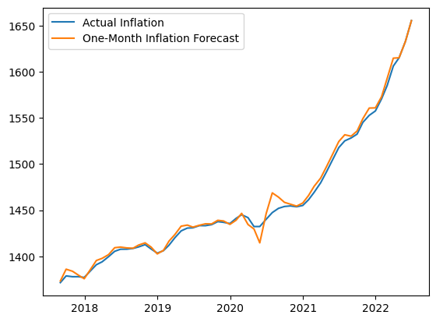
One-Month Rolling Inflation Forecast
Notes:
“Now look at this forecast”
Reiterate that this is a rolling forecast, we essentially know what’s going to happen next month

Slide 9
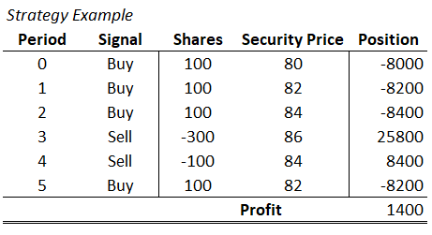
Full-Commitment Strategy
Since the forecast was very good at predicting the one-month movements of inflation, we decided to make our strategy a rolling strategy
Each month we forecast inflation based on the new indicator data
We train the model using past inflation and security movements
Using our forecast, we receive a signal about the future movement of the security
Using this signal, we either buy or short sell 100 shares of the selected securities.
If we had a position long position and get signal that inflation will decrease, we sell our position.
Notes:
Explain that position should “change in position”
After everything:
We’re essentially fully committing that our signals are right.

Slide 10
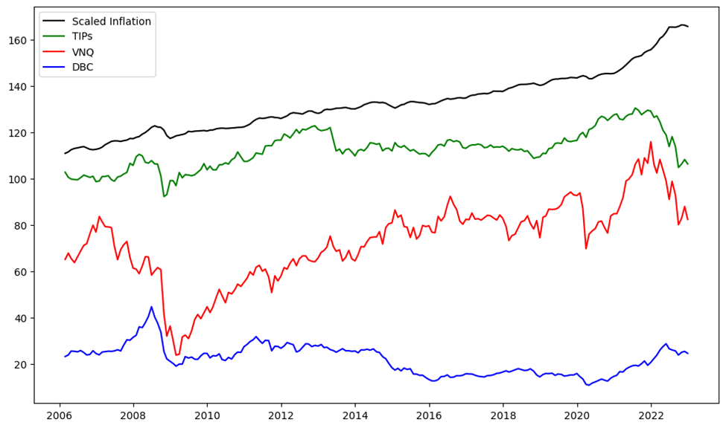
Quick Look at our Variables
Notes:
Before our results one quick look at the movement of our three securities plus inflation
Note that by-and-large the securities somewhat look similar until reach that point at the end of 2021

Slide 11
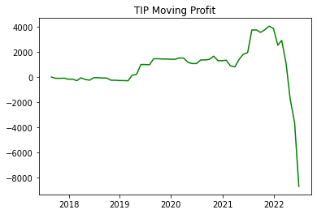
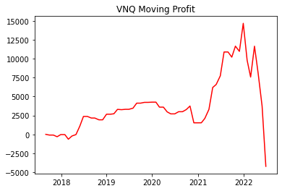
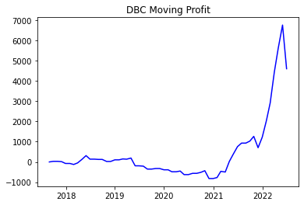
Strategy Profitability
Notes:
This is simply the profit using the autoregressive model
Note the irony of trying to make profit out of this rapid increase in inflation and that’s what ended up sort of causing these massive profit declines.

Slide 12
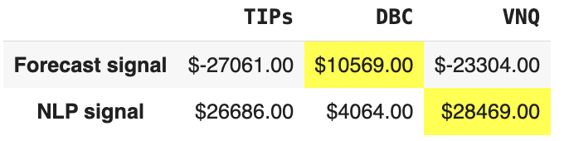
Strategy Performance with Chosen Securities
Simulated profit of
DBC with inflation-forecast signal
VNQ with NLP signal
Number of trades simulated
Inflation-forecast signal produces more buy/sell executions
Return over test period, from January 2018 to June 2022
NLP signal, as being static and less orders, generates better yet negative result

Slide 13
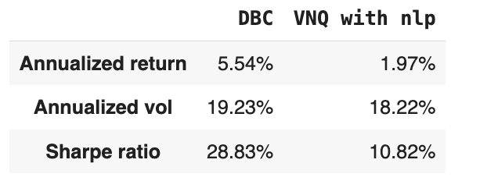
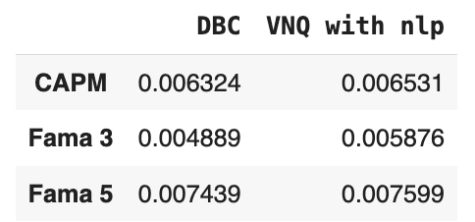
Strategy Result and Performance Benchmarks
Portfolio ends with positive profit in general has negative return
COVID period brought in much unexpected variation to forecast
Trades simulated during the period are not optimal
Due to same reasoning, we observe the portfolios’ performance against
CAPM
Fama French 3 factors
Fama French 5 factors

Slide 14
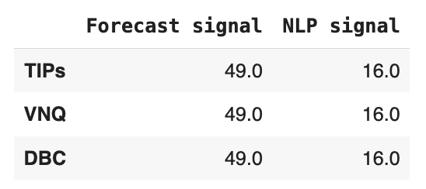
Future Steps and Conclusion
Conclusions:
Forecasting long term movements of the inflation is difficult, but short term is feasible
We did not find a security that closely matched the movements of inflation throughout the entirety of it path
Future Steps:
Inclusion of TIPS price instead TIPS ETF
Search for other variables that can address inflation forecast to increase accuracy
Fed funds rate
Discover countries with features of high inflation with detaining effort
Simulate trades on such countries’ inflation-protected security
Produce more dynamic NLP information as execution signal
Stop-loss mechanism
Notes:
More granular analysis could be performed

Slide 15
Q&A
Thank your time! Any questions?

Slide 16
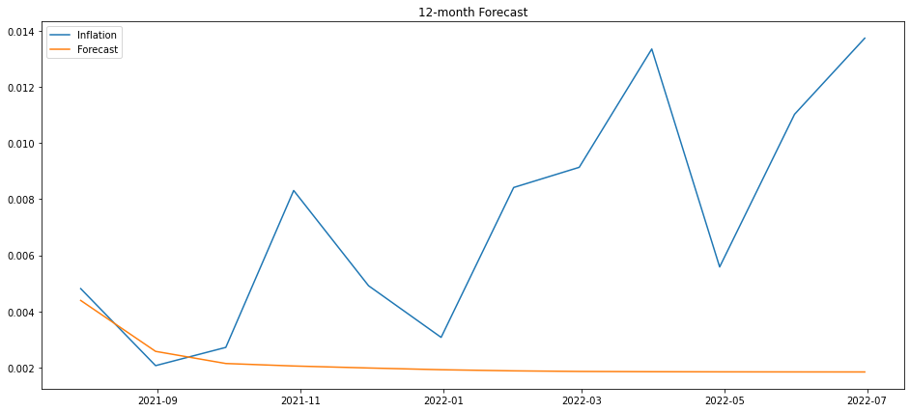
Appendix A - Full Economic Indicators Forecast

Slide 17
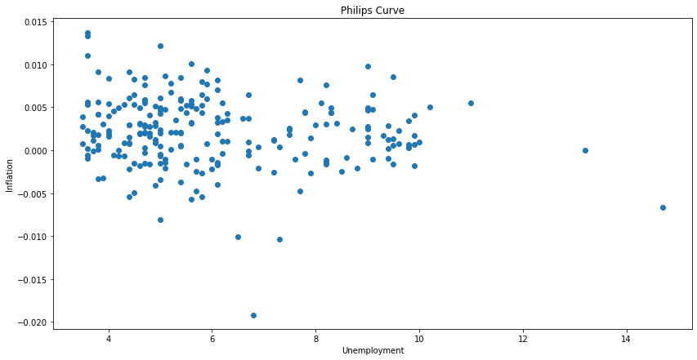
Appendix B - Phillips Curve

Slide 18
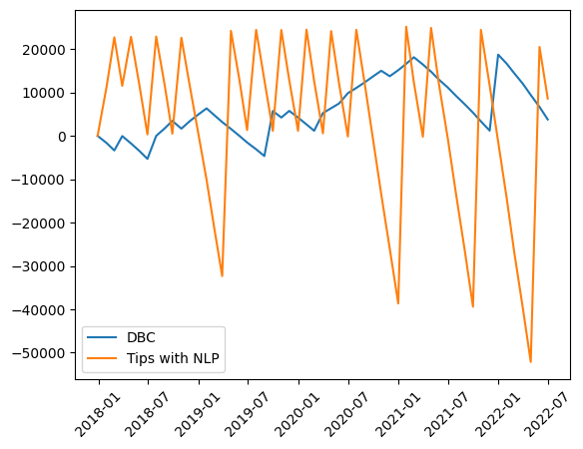
Appendix C - Portfolios Balance over time

